Slide 1
Presentation 7
Integrating quality activities in
the project life cycle
Software development methodologies:
- The software development life cycle (SDLC)
model
- The prototyping model
- The spiral model
- The object-oriented model
Factors affecting intensity of SQA activities
Verification, validation and qualification
Development and quality plans for small and for internal projects
A model for SQA defect removal effectiveness and cost

Slide 2
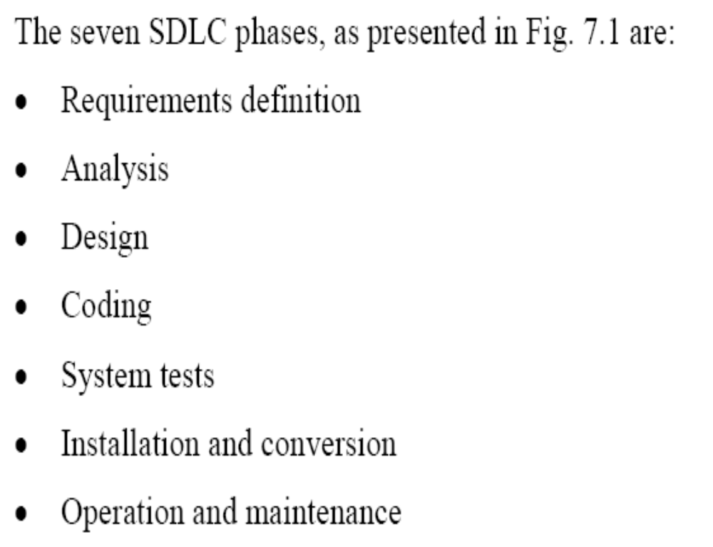

Slide 3
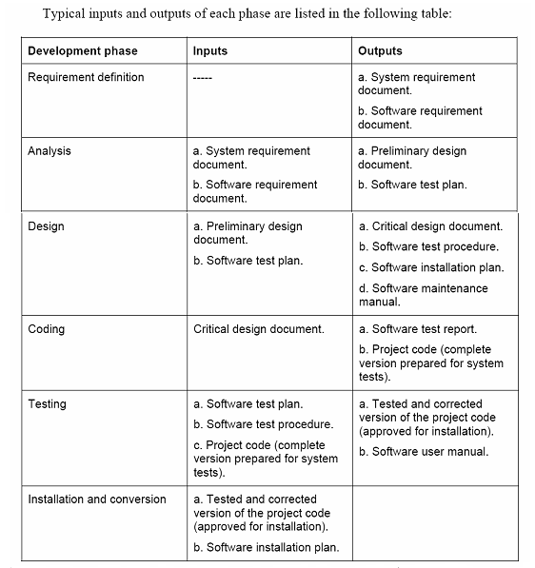

Slide 4
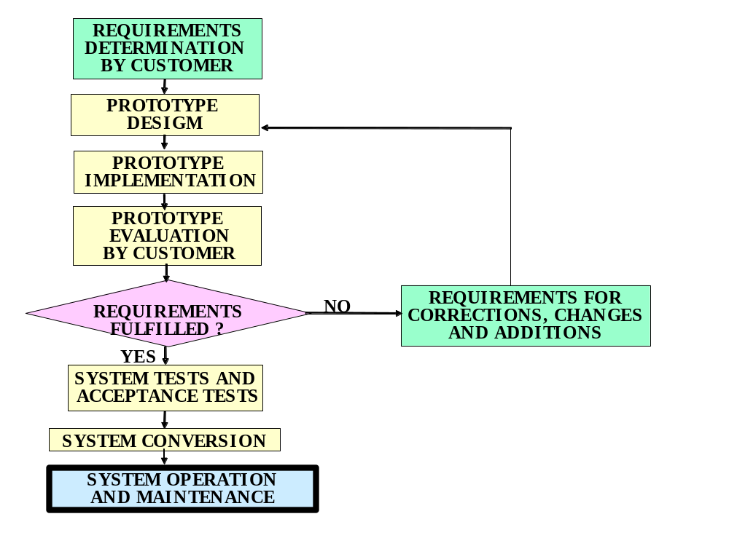
The prototyping model

Slide 5
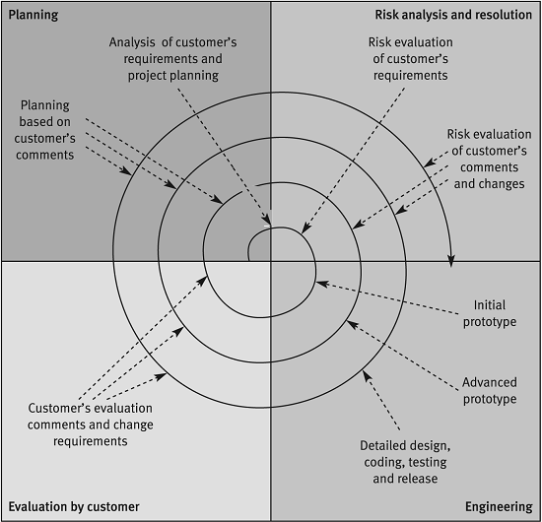
The Spiral Model
Source: After Boehm 1988 (© 1988 IEEE)

Slide 6
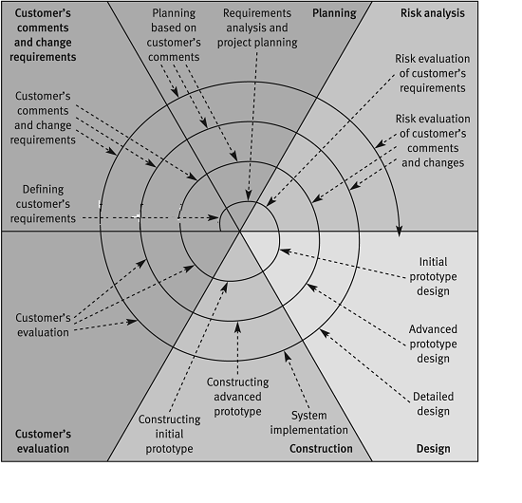
The Advanced
Spiral model The Win-Win Model
Source: After Boehm 1998 (© 1988 IEEE)

Slide 7
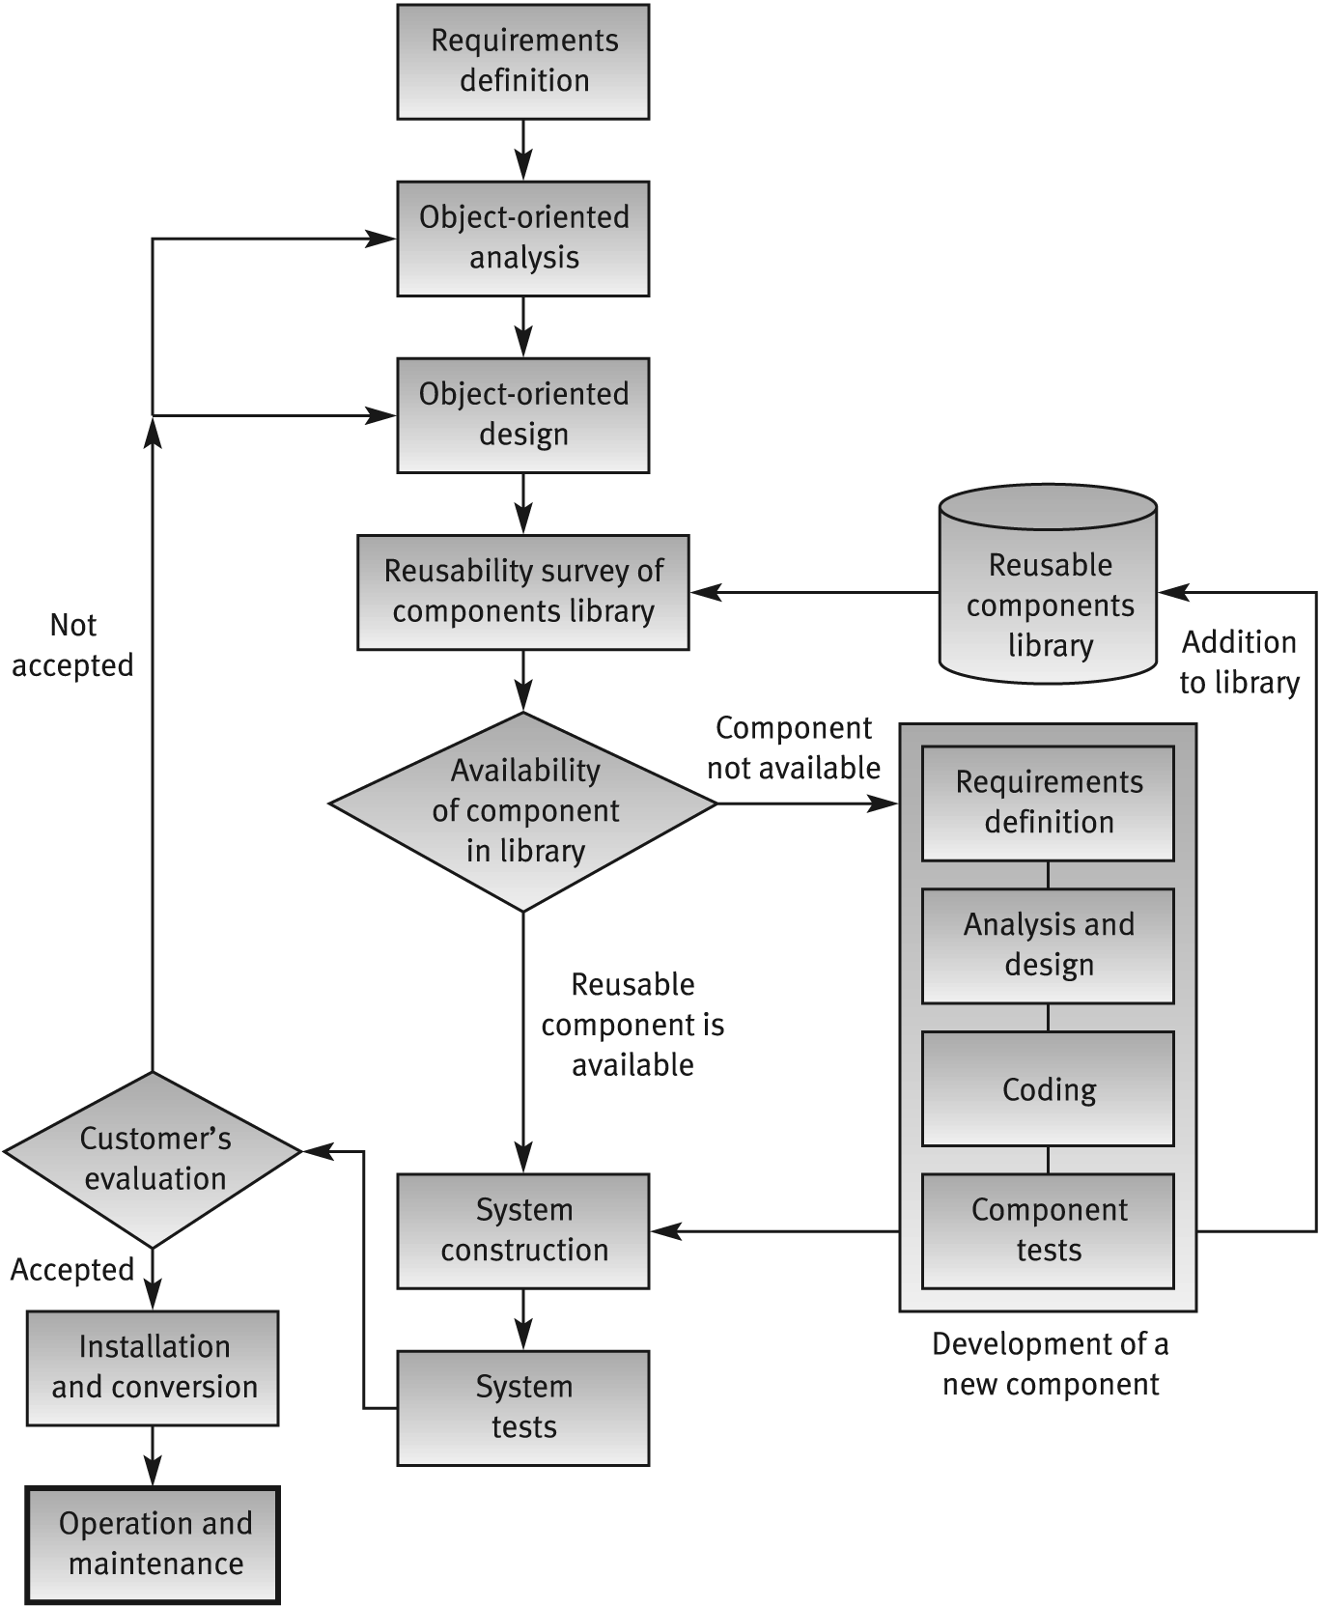
Object Oriented
Development Model

Slide 8
Factors affecting the required
intensity of SQA activities
Project factors:
Project’s magnitude
Project's technical complexity and difficulty
Extent of reusable software components
Severity of failure outcomes if the project fails
Team factors:
The professional qualification of the team members
Team acquaintance with the project and its experience in the area
Availability of staff members that can professionally support the team
Familiarity with the team members, in other words, the percentage of new staff members in the team

Slide 9
See Example 1 and Table 7.1 as well as Example 2 and Table 7.2

Slide 10
Three aspects of quality assurance of software product are examined: verification, validation, and qualification.

Slide 11
Verification, validation
and qualification
Verification – The process of evaluating a system or component to determine whether the products of a given development phase satisfy the conditions imposed at the start of that phase
Validation - The process of evaluating a system or component during or at the end of the development process to determine whether it satisfies specified requirements
Qualification - The process used to determine whether a system or component is suitable for operational use
IEEE Std 610.12-1990 (IEEE 1990)

Slide 12
Model for SQA defect removal
effectiveness and cost
The model’s quantitative results:
a. The SQA plan’s total effectiveness in
removing project defects
b. The total costs of removal of project defects

Slide 13
Defects originating
and defect removal costs
Software development phase | Average % of defects originating in phase | Average relative defect removal cost
Requirement specification | 15% | 1
Design | 35% | 2.5
Unit coding | 30% | 6.5
Integration coding | 10% | 16
Documentation | 10% | 40
System testing | ----- | 40
Operation | ----- | 110

Slide 14
Defects removal effectiveness
for quality assurance plans
Quality assurance activity | Defects removal effectiveness for standard SQA plan | Defects removal effectiveness for comprehensive SQA plan
Specification requirement review | 50% | 60%
Design inspection | ----- | 70%
Design review | 50% | 60%
Code inspection | ----- | 70%
Unit test | 50% | 40%
Integration tests | 50% | 60%
Documentation review | 50% | 60%
System test | 50% | 60%
Operation phase detection | 100% | 100%

Slide 15
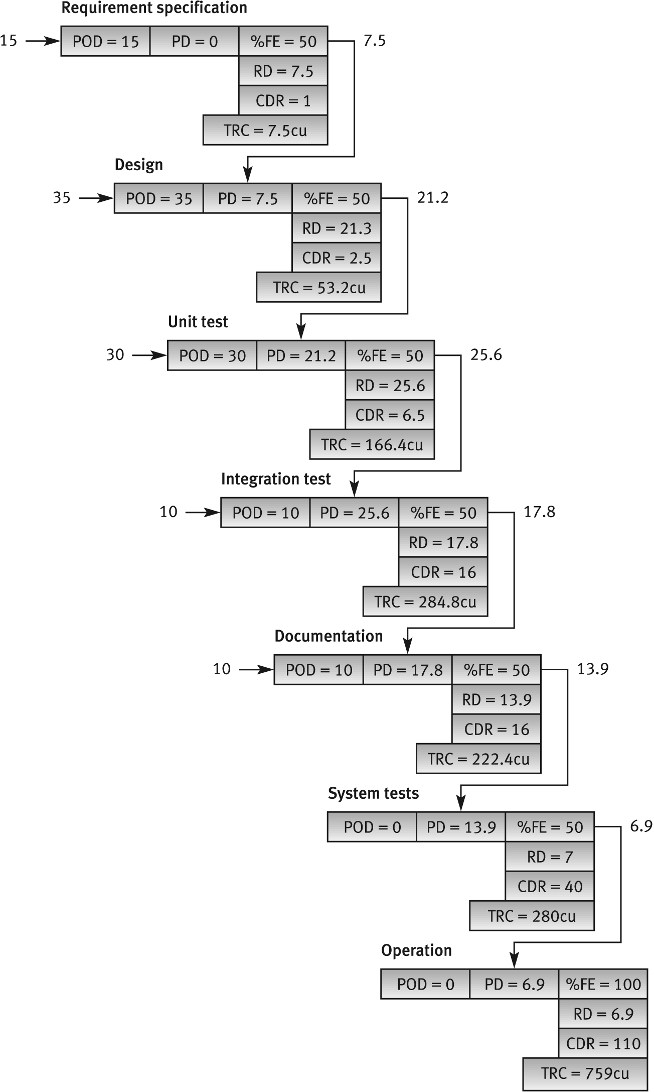
The standard quality assurance plan
The process of removing 100 defects
• POD = Phase Originated Defects
• PD = Passed Defects (from former phase or former quality assurance activity)
• %FE = % of Filtering Effectiveness (also termed % screening effectiveness)
• RD = Removed Defects
• CDR = Cost of Defect Removal
• TRC = Total Removal Cost. TRC = RD x CDR.

Slide 17
See Figure 7.8 and Table 7.8

